Slide 1
Shell Bootcamp 2024 – TECHNICAL FOUNDATION Reflections for Day 2 (30-Aug-2024)
Hitesh
Date : 30-Aug-2024

Slide 2

My learnings from this week!

Slide 3
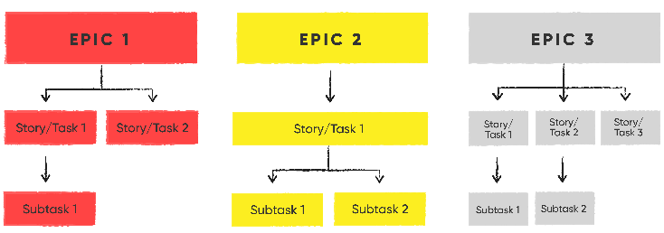
Learning 1 | My takeaways
Epic
Definition: A large body of work that can be broken down into multiple smaller stories. An Epic usually takes multiple sprints to complete.
Example: Developing a new feature like "User Authentication" for an application, which may include several stories like "Login Page," "Sign Up," and "Password Reset."
Story
Definition: A user requirement that is detailed enough to be estimated and implemented in a sprint. It often follows the format: "As a [type of user], I want [an action] so that [a benefit]."
Example: "As a user, I want to reset my password so that I can regain access to my account if I forget my password."
Task
Definition: A specific piece of work that developers and testers break down from a story to estimate, develop, and test. Tasks are the actionable items in a sprint.
Example: "Design the reset password page UI" or "Implement password reset functionality."
Sub-Task
Definition: Smaller portions of a parent task, each assigned and tracked individually. Sub-tasks help distribute the workload among team members.
Example: "Create a front-end form for password reset" under the task "Implement password reset functionality."

Slide 4
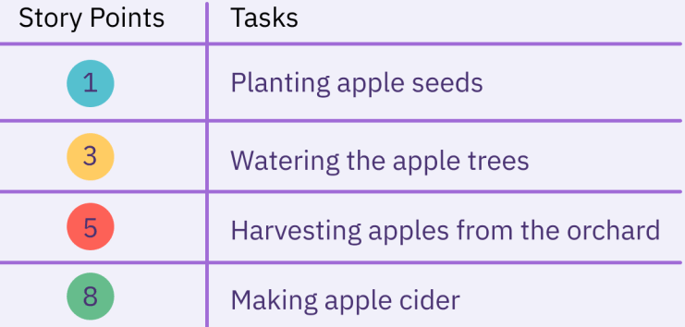
Learning 2 | My takeaways
Enabler Story
Definition: Supports activities necessary for future functionality, extending the architectural runway.
Example: Setting up a continuous integration pipeline.
Spike
Definition: A time-boxed task for research or problem-solving to reduce risks or unknowns.
Example: Researching how to integrate OAuth 2.0 for authentication.
Story Pointing
Definition: Measures effort using story points, considering complexity, amount, and uncertainty. Often uses Fibonacci sequence.
Example: A login button might be 1 point; integrating third-party authentication could be 8 points.
Definition of Ready (DoR)
Definition: A checklist that ensures a story is well-defined and actionable before being picked up for a sprint.
Example: Acceptance criteria are defined, and dependencies are identified.
Definition of Done (DoD)
Definition: A set of criteria a story must meet to be considered complete, ensuring all aspects are finished.
Example: Code is written, tested, reviewed, and deployed to staging.

Slide 5
Learning 3 | My takeaways
Scrum Board
Definition: A visual representation of work to be done, in progress, and completed within a single sprint. It's used to track the status of stories, tasks, and sub-tasks.
Example: Columns on the board might include "To Do," "In Progress," "In Review," and "Done."
Agile Workflow
Definition: The process flow followed in Agile, typically involving stages like "Backlog," "In Development," "In Testing," and "Done." It ensures that work progresses smoothly through the sprint.
Example: A story moves from the backlog to "In Development," then to "In Testing," and finally to "Done" as it passes each stage of the workflow.
Agile Product Roadmap
Definition: A high-level strategic plan that outlines the development and release timeline of the product. It aligns the team's work with business objectives.
Example: "Q1: Implement user authentication; Q2: Develop shopping cart; Q3: Launch MVP."
Time Estimation
Definition: The process of predicting the amount of time needed to complete a task, story, or epic. Estimation is crucial for planning sprints and releases.
Example: Estimating that "Implement password reset" will take 3 days to complete.

Slide 6
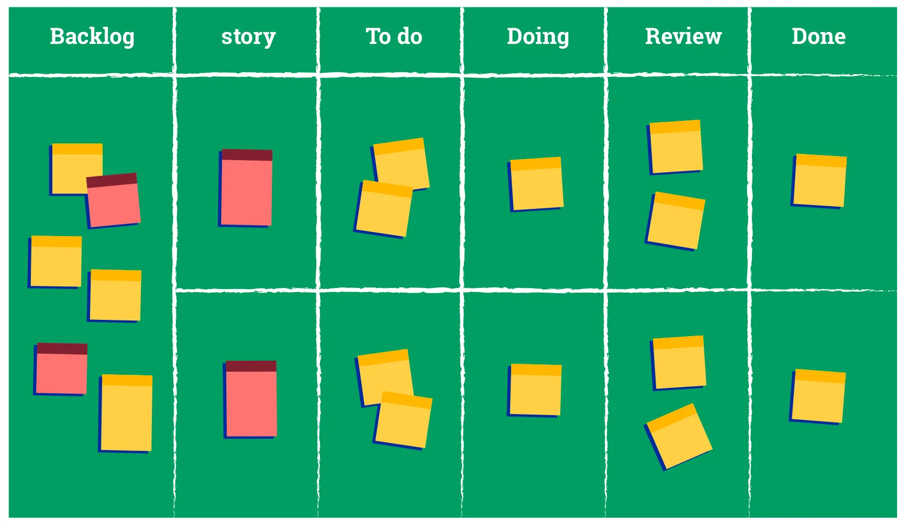
Learning 3 | My takeaways
Scrum Board

Slide 7
Learning 4 | My takeaways
Logging Work
Definition: The practice of recording the time spent on tasks or stories in a sprint. This helps in tracking progress and adjusting future estimations.
Example: Logging 5 hours spent on "Creating the reset password UI."
Kanban Board
Definition: A visual tool used in Kanban methodology to manage workflow and improve efficiency. It helps teams visualize their work, limit work in progress, and maximize flow.
Why Use It?: Kanban boards are flexible and can be used for continuous delivery, making them suitable for teams that prioritize work on a rolling basis rather than fixed sprints.
Fibonacci Numbers in Estimation
Definition: Fibonacci numbers are used in Agile estimation because the sequence grows in a non-linear way, reflecting the increasing uncertainty and complexity as work becomes more extensive.
Example: A task that is slightly more complex than a 3-point story might be estimated as a 5-point story, and something even more complex might be an 8 or 13-point story.

Slide 8
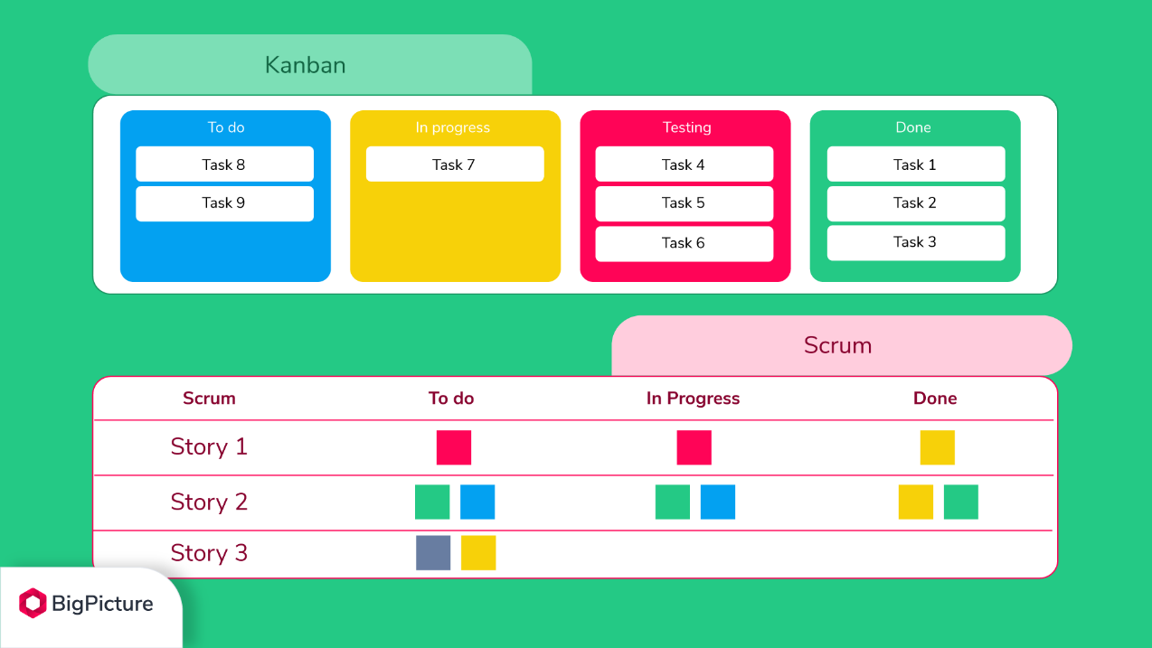
Learning 4 | My takeaways

Slide 9
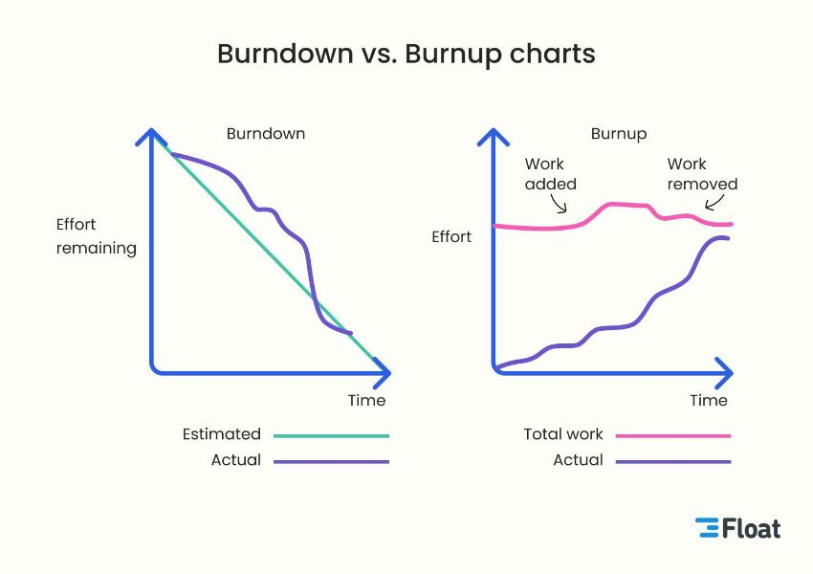
Learning 5 | My takeaways
Burn-Up vs. Burndown Charts
Definition:
Burn-Up Chart: Shows progress toward a goal by plotting completed work against the total scope, allowing teams to see how close they are to achieving the sprint or release goal.
Burndown Chart: Plots remaining work against time, showing how much work is left to complete within the sprint or project timeline.
Example: A burn-up chart might show a steady increase in completed story points, while a burndown chart might show the remaining story points decreasing over time.

Slide 10
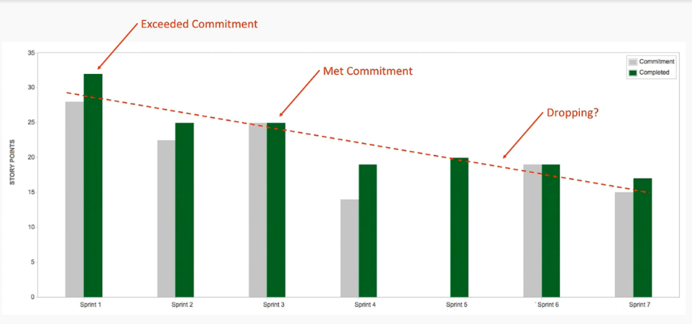
Learning 6 | My takeaways
Velocity Charts
Definition: These charts track the amount of work a team completes in a sprint (measured in story points), helping predict how much work can be done in future sprints.
Example: If a team consistently completes around 20 story points per sprint, that becomes their velocity.

Slide 11
Thank You

